Slide 1
National Sanitary and Phytosanitary (SPS) Workshop NRCS presentation 11 March 2021
presentation by: Maphuti Kutu
Technical Specialist: Foods

Slide 2
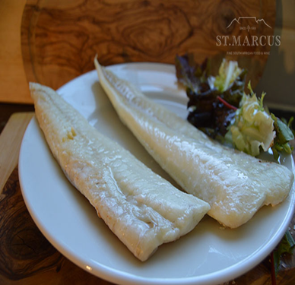
Presentation outline
Introduction to NRCS
Key Provisions: SPS Agreement
NRCS Act - Mandate
Development of technical regulations & NRCS VCs
FAI inspection program
Challenges/ Opportunities

Slide 3
The NRCS
Public entity
Reports to the Minister of Trade, Industry and Competition
Administration of Compulsory Specifications (technical regulations)
Competent authority for fish and fishery products
Value chain approach - To co-ordinate the for fish and fishery products including aquaculture, NRCS has a MOU with DEFF- Fisheries.

Slide 4
Part of the DTIC technical infrastructure entities
Ministry: dtic
The South African Bureau of Standards
SABS
The NRCS
South African National Accreditation System:
SANAS
The National Metrology Institute of SA:
NMISA

Slide 5
Key Provisions: SPS Agreement
Non-discrimination
Scientific justification
Harmonization (Codex, IPPC &OIE)
Risk assessment
Consistency
Least trade-restrictiveness
Equivalence
Regionalization
Transparency
Technical assistance/special treatment
Control, inspection and approval procedures

Slide 6
NRCS Act (Act No. 5 of 2008)
Compulsory Specifications mandate:
–“13. (1) The Minister may, in respect of any commodity, product or service which may affect public safety, health or the environment, by notice in the Gazette (a) declare a SANS or a provision of a SANS to be a compulsory specification…”
Applicable to products that are IMPORTED, MANUFACTURED, SOLD and/or EXPORTED - must comply with mandatory requirements if within scope of VC
Technical regulations/ Compulsory Specifications lay down compulsory requirements for
Technical requirements: product or service characteristics or their related processes; production methods (may refer to SANS/international standards);
Administrative requirements ; and
Conformity assessment requirements…
…with which compliance is mandatory – NRCS inspection/enforcement.

Slide 7
NRCS Process flow
Process Flow
Request for regulation
Enforcement of regulations
Development of TR
Pre- market approval
Inspection
Sampling
Testing
Sanction
In-house Technical Specialist.
Industry Participation.
NRCS Act prescribes referencing the SABS Standard if available
Admin Process.
LOA & Sales Permit.
Proof of Compliance
In-house Inspectors.
Automotive
Chemicals & Materials
Electro-technical
Food
Random
On request
Accredited testing facilities
CEO directive

Slide 8
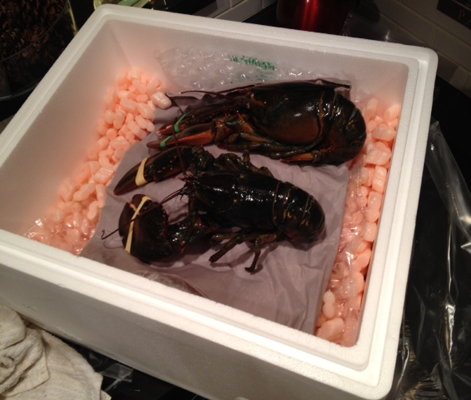
Development and approval of technical regulations
Technical stakeholder working group meeting
i
Risk Assessment (Report to PAC) – YES/NO
i
Draft technical regulation
i
Full stakeholder working group meeting
i
Impact Assessment (Report to PAC) – YES/NO
i
Full stakeholders’ meeting/ Final draft regulation
i
Submit to Management & Minister (dtic) for review & approval
i
First gazetting for comments (60 days)
WTO notification
i
Comments review
i
To Management & Minister(dtic) for final gazetting

Slide 9
Development and approval of technical regulations – RA
Principle one: recognized international standards and/or code of practices – mainly Codex
measures which conform to international standards, guidelines or recommendations shall be deemed to be necessary to protect human, animal or plant life or health, and presumed to be consistent with the relevant provisions of the WTO SPS Agreement.
Principle two: Applying international standards to national realities
Available quantitative data e.g. import and export data, trends analysis etc.
Principle three: Using qualitative and assumed data from international sources
Principle four: identified problem statements for official research in collaboration with national available institutions

Slide 10
NRCS Foods Compulsory Specifications (VCs)
Compulsory Specification for Frozen Fish, Frozen Marine Molluscs and Frozen products Derived there from VC8017 (SANS 585)
The Manufacture, Production, Processing and Treatment of Canned Fish, Canned Marine Mollusks and Canned Crustaceans VC8014 (SANS 587)
The Manufacture, Production, Processing and Treatment of Canned Meat Products VC8019 (SANS 1675)
Compulsory Specification for Frozen Rock Lobster Products Derived there from VC8020 (SANS 2074)
Compulsory Specification for Frozen Shrimps (Prawns), Langoustines and Crabs VC8031 (SANS 788)
Compulsory Specification for Smoked Snoek (to include all smoked fish species) VC8021 (SANS 2877)
Compulsory Specification for Live Aquaculture Abalone VC9001 (SANS 729)
Compulsory Specification for Live Lobster VC9104 (SANS 1680)
Compulsory Specification for Aquaculture live and raw chilled bivalves (oysters, mussels etc.) VC9107 (SANS 2879)
Compulsory Specification for Processed meat products VC 9100 (SANS 885)

Slide 11
FAI Inspection program
Factory requirements
Equipment for production
Pre-requisite requirements (GMP)
Processing/ product requirements
Requirements for employees
Safety and quality product evaluation
(As per pre-determined schedules and/or sampling plans
Sanctioning of non-compliant product
Test methods
Water/Ice
Chemical evaluation (As per sampling plans)
Microbiological evaluation (As per sampling plans)
Traceability of products
Legal Metrology requirements
Labeling requirements (R146 & SANS/VC)
Food Safety Management System (e.g. HACCP)
Risks Management throughout the value chain
Regulatory hazards
Accredited Inspection Program
Notes:
Fish Meat Non Compulsory related
78 12 10

Slide 12
Conformity Assessments – Testing labs
NRCS uses external laboratories – mainly Microbiological tests - Check accreditation status at the SANAS Website
SABS Commercial (Pty) Ltd and private labs
Monitoring for fishery products export – NRCS (CA) wild species
- DEFF farmed species
- additional testing requirements from importing countries
- Some of the testing that cannot be conducted in SA

Slide 13
Challenges/Opportunities
Maintenance of the SPS compliance profile for aquaculture products
Legislation
Enforcement
Laboratory scope
Adhoc Fora -Priorities
Governance/Coordination

Slide 14
Challenges/Opportunities
Diverse/improved market access for aquaculture products to be still pursued from a sanitary compliance point
-Monitoring for fishery products export = NRCS/DEFF e.g. Contaminants,
Marine Biotoxins, Micro, drug residues etc.
- Stakeholder engagement, specialized tests – DEFF = other national labs
ARC/OVI, NHLS etc.
Harmonization drives - The NRCS represent South Africa and leads the delegation at the Codex Committee for Fish and Fishery Products (CCFFP). Also participate in CCFH & CCFICS
Other harmonization drives e.g. ARSO, SADCstan, SADCTLRC
Participate in the national SPS committee and related regional/international committees
Technical cooperation with trading partners

Slide 15
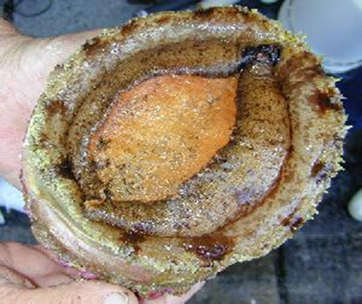
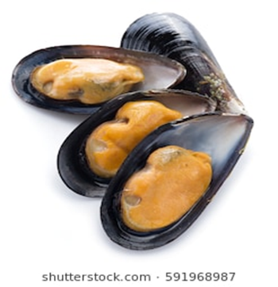
012 4828700/0215263400
www.nrcs.org.za
Maphuti.kutu@nrcs.org.za/Thandeka.zulu@nrcs.org.za
Thank You

